Slide 1
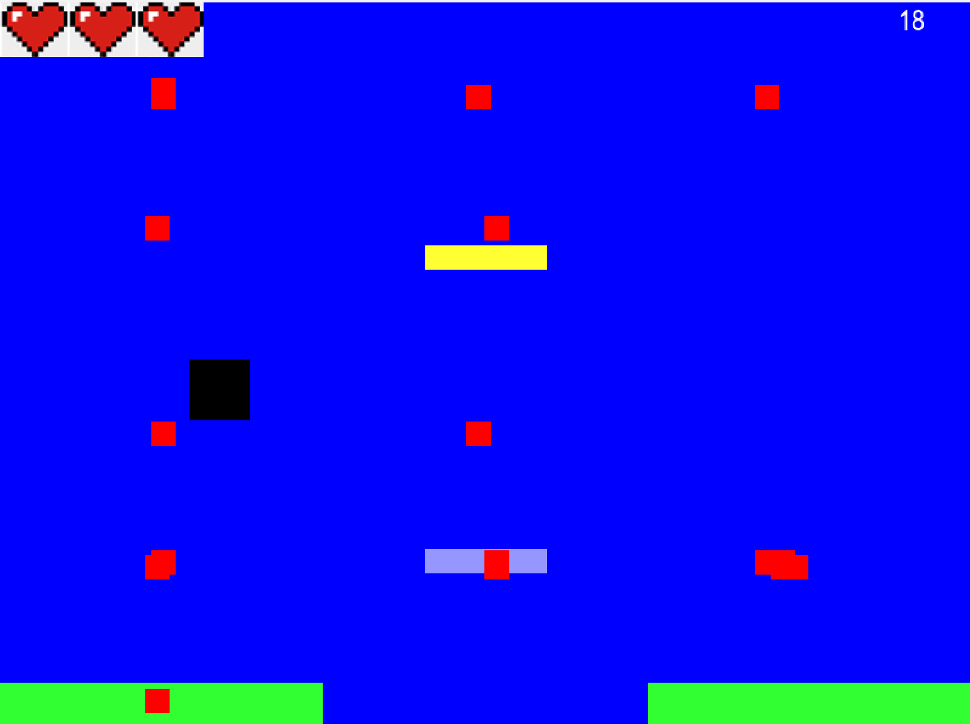
Geometry Wars
Game by Jaime Cesar Zorrilla

Slide 2
Goal & pride
The goal was to create a game with a focus on challenging gameplay and interesting lore. Under this, the specific goals were
The thing I am most proud of is the respawn mechanic

Slide 3
Process

Slide 4
Problem & future

Slide 5
Code

